Slide 1
structuring your code
Dr. Domhnall Carlin, QUB

Slide 2
The Zen of Python by Tim Peters
Beautiful is better than ugly.
Explicit is better than implicit.
Simple is better than complex.
Complex is better than complicated.
Flat is better than nested.
Sparse is better than dense.
Readability counts.
Special cases aren't special enough to break the rules.
Although practicality beats purity.
Errors should never pass silently.
Unless explicitly silenced.

Slide 3
The Zen of Python by Tim Peters
In the face of ambiguity, refuse the temptation to guess.
There should be one-- and preferably only one --obvious way to do it.
Although that way may not be obvious at first unless you're Dutch.
Now is better than never.
Although never is often better than *right* now.
If the implementation is hard to explain, it's a bad idea.
If the implementation is easy to explain, it may be a good idea.
Namespaces are one honking great idea -- let's do more of those!

Slide 4
How do I start with this?
Code is read way more than it is written
Readability is fundamental in python
Document your code
Use clear and purposeful names
Whitespace can be more important than the writing

Slide 5
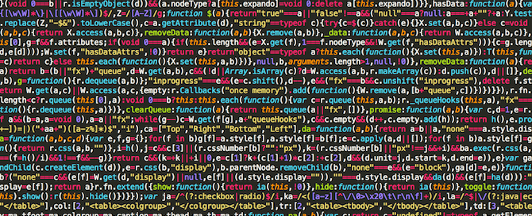
maibushyx.blogspot[.]com/2021/06/tool-to-minify-javascript[.]html

Slide 6
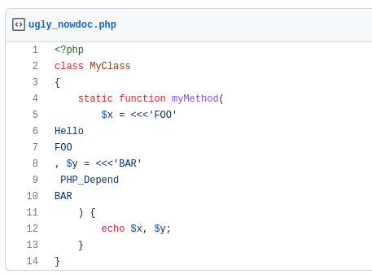
https://gist.github.com/manuelpichler/1405317

Slide 7
❝Any fool can write code
that a computer can understand.
Good programmers write code
that humans can understand. ❞
Martin Fowler, Kent Beck, John Brant, William Opdyke, and Don Roberts (1999) Refactoring: Improving the Design of Existing Code. Addison-Wesley.

Slide 8
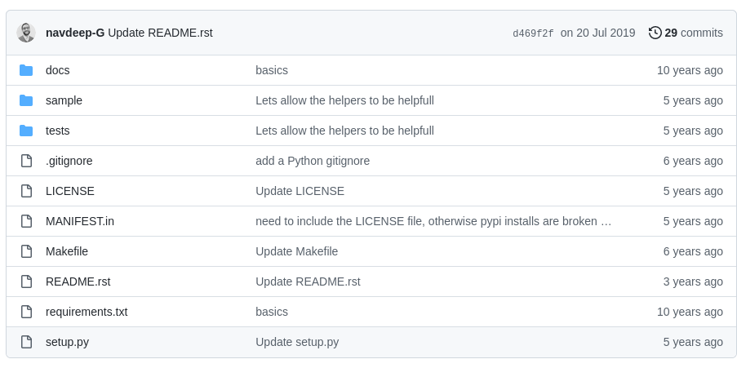
https://github.com/navdeep-G/samplemod

Slide 9
|-- CITATION
|-- README
|-- LICENSE
|-- requirements.txt
|-- data
| |-- birds_count_table.csv
|-- doc
| |-- notebook.md
| |-- manuscript.md
| |-- changelog.txt
|-- results
| |-- summarized_results.csv
|-- src
| |-- sightings_analysis.py
| |-- runall.py

Slide 10
Toolchest
Google code formatter: https://github.com/google/yapf/
Python style guide (PEP8): https://www.python.org/dev/peps/pep-0008
Pycodestyle: https://pypi.org/project/pycodestyle/
Black (highly opinionated code formatter): https://black.readthedocs.io/en/latest/
Fowler, M. (2018). Refactoring: Improving the Design of Existing Code. [electronic resource].. Addison-Wesley Professional. (available in QUB library)

